Slide 1
ASSIGN 2
Artificial Neural Network

Slide 2
Artificial Neural Networks
Nehal Rajlaxmi Tanmay Alok

Slide 3
Problem Statement
To implement back propagation algorithm (BP) on feedforward neural networks (FFNN).
Run FFNN on:
2-input NAND, NOR, XOR
5-input palindrome, majority
6-input parity
Twitter Corpus
IRIS Data
MONK Data
Observe the effect of learning rate, momentum factor,

Slide 4
Results and Observations

Slide 5
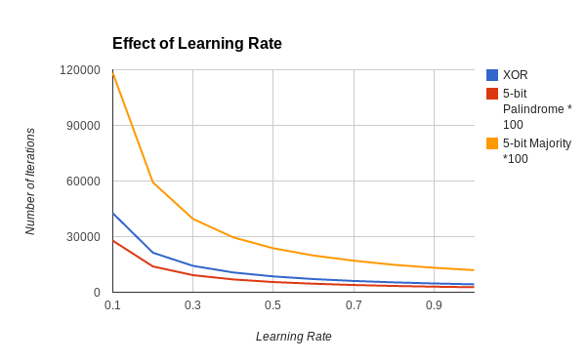
Learning Rate
If we increase the learning rate, lesser number of iterations are required because larger steps taken. But there is a risk of passing over the minimum and not converging.

Slide 6
Momentum Factor
Momentum adds a factor M (Momentum factor) to of the previous weight change to the current one. This will result in larger steps when the gradient is large and smaller steps when the gradient is low. This allows the algorithm to help not to pass over the minimum which can happen in the case of large learning rate and no momentum.
The effect of momentum factor depends on the initialization of weights. Since, we used random weights, no specific pattern in the plot can be seen. If the initialization point of graph is too away from the minimum, then the number of iterations taken will be lesser for higher momentum, provided the algorithm does not rush past the minimum.

Slide 7
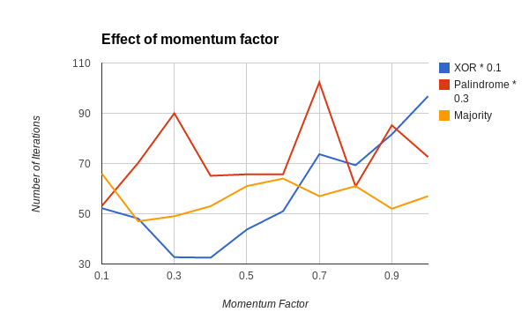
Momentum Factor

Slide 8
Effect Of Initialization of weight vectors
Initialization of the weights affects the number of iterations required by the program to converge.
In case of functions (e.g. XOR), initialization can make the algorithm to terminate in different local minima.

Slide 9
Symmetry
If all the weights are initialized to same value, after any number of iterations the value of the weights will remain equal to one another.
This will result in smaller weight space from which we will find the one at minimum. So, the accuracy in this case should be less than that in case of randomly assigned weights.

Slide 10
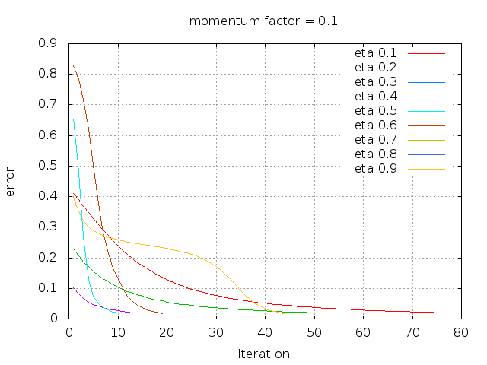
Error vs. Iteration
XOR

Slide 11
Local Minima
When a local minima is obtained, error rate does not decrease further.
Local minima can be avoided if learning rate is high or momentum is high.

Slide 12
Saturation
When output of any neuron doesn’t change much and sticks to the one extreme (1 or 0) , that neuron is saturated
When neurons are saturated, error rate doesn’t decrease and hence back propagation doesn’t converge.

Slide 13
Hidden Layer function (XOR)
XOR function has many local minima. It converges to any of these minima according to the initialization and learning rate.
For learning rate 0.6
The equations of the two hidden layer neurons are - (a+b') and ab'
For the output layer, the equation is - (a'+b)
And the equation of XOR(a, b) can be written as
XOR(a,b) = (a + b’)’ + (ab’)

Slide 14
Hidden Layer function (XOR)
For learning rate 0.1
The equations of the two hidden layer neurons are - ab and a + b
For the output layer, the equation is - a’b
And the equation of XOR(a, b) can be written as
XOR(a,b) = (ab)’(a + b)
For learning rate 0.7
The equations of the two hidden layer neurons are - a’b’ and ab
For the output layer, the equation is - a’b’
And the equation of XOR(a,b) can be written as
(a’b’)’(ab)’

Slide 15
Hidden Layer function (5 bit Palindrome)
For learning rate 0.6
The equations of the two hidden layer neurons are -
b’d + ade’ + ab’e’
bd’ + a’d’e + a’be
For the output layer, the equation is - (ab + a’b’)
For the final layer, the equation thus becomes (which is also the equation of 5 bit palindrome) -
a’b’d’e’ + a’bde’ + abde +ab’d’e

Slide 16
Effect of Learning Rate and Momentum
If learning rate and momentum factor are both low, then the number of iterations taken for convergence of the algorithm is high.
If learning rate and momentum factor are both high, then the number of iterations taken for convergence of the algorithm is less. But there is also a possibility that the algorithm may pass over the local minima.
If learning rate is high and momentum factor is very low, then then the number of iterations taken for convergence of the algorithm is less. But again there is also a possibility that the algorithm may pass over the local minima.
If learning rate is low and momentum factor is high, then then the algorithm will take approximately same size steps. Once again there is also a possibility that the algorithm may pass over the local minima.

Slide 17
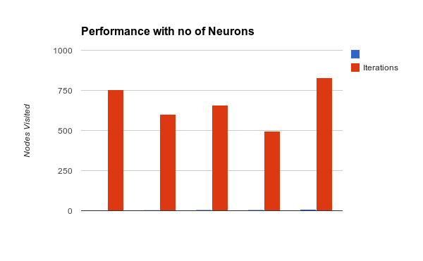
Iterations vs. No of hidden layer neurons

Slide 18
Digit Recognizer
Implementation:
Input is seven bits (0 or 1) depending on the digit
6 hidden neurons are used
Three neurons are used as output depending on binary value of the digit

Slide 19
Twitter Sentiment
Feature Extraction
First we check if there exists an exclamation mark or and ‘“n’t” in the tweets. Four features are set to 1 on occurrence of each of these.
Then we remove all the URLs and punctuation marks in the tweets.
Then the tweet is split into words and each word is stemmed.
Our feature vector is a set of all words in the corpus who occur more than once.
If a word in the corpus occurs in the tweet, then that feature is set to 1. Otherwise, it is zero. The feature vector is then used for training or testing as required.

Slide 20
Twitter Sentiment
Once feature vector is extracted, we can try two approaches:
Three neurons in output layer with following meanings for their outputs
1 0 0 - positive
0 1 0 - negative
0 0 1 - objective
First differentiate between negative and positive/objective. Then if positive/objective, differentiate between them using another neural network.

Slide 21
Twitter Sentiment
Dataset | Corpus 1 | Corpus 2
1 | 54 | 50
2 | 65 | 49
3 | 60 | 47
4 | 56 | 48
5 | 59 | 51
Total | 59 | tw49

Slide 22
IRIS Dataset
Dataset Number | Correct | Total | Percentage
1 | 27 | 30 | 90
2 | 20 | 30 | 67
3 | 23 | 30 | 77
4 | 19 | 30 | 63
5 | 26 | 30 | 87
Total | 115 | 150 | 77

Slide 23
MONK Dataset
Dataset Number | Correct | Total | Percentage
1 | 361 | 432 | 84
2 | 338 | 432 | 78
3 | 371 | 432 | 86
Total | 1070 | 1269 | 83

